Slide 1
The Journey of Vienna
Presented by: Harrison Mark, Mackenzie Marci and Michelle Diblasio

Slide 2
“Twenty years from now you will be more disappointed by the things you didn't do than by the ones you did. So throw off the bowlines, sail away from the safe harbor. Catch the trade winds in you sail. Explore. Dream. Discover.” -Mark Twain

Slide 3
GLS Course Overview
A quarter long course that introduces students to important aspects of a global city including
The culture
The history
The people
The food
To complete this course we were given the opportunity to travel to that global city

Slide 4
Vienna, Austria
(our adventure)

Slide 5
Getting to Vienna

Slide 6
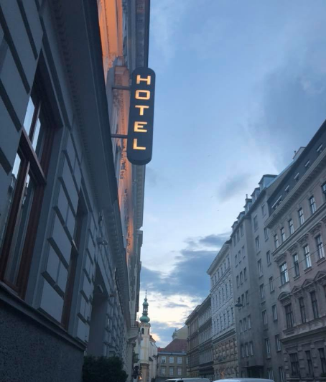
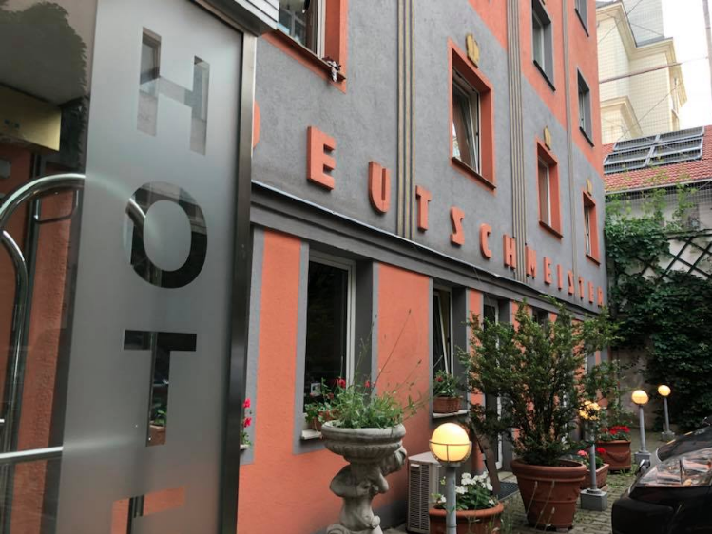
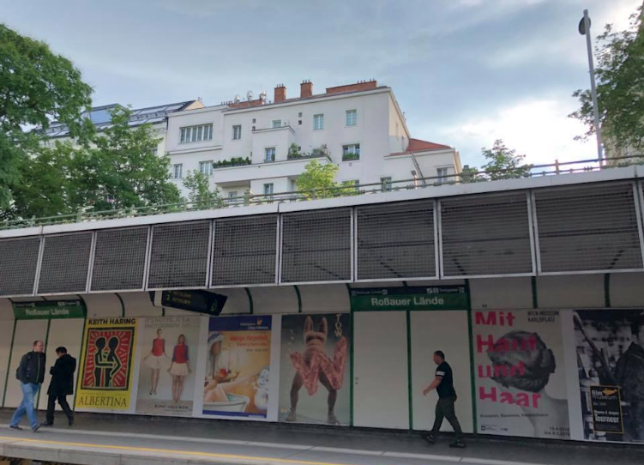
Hotel Deutschmeister
Right near our subway station
Close walk to the Donaukanal

Slide 7
History
(Geschichte)

Slide 8
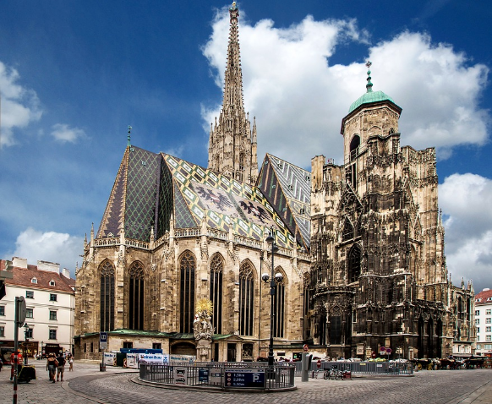
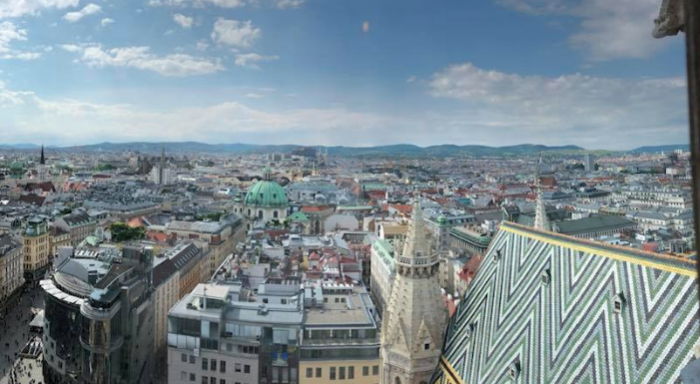
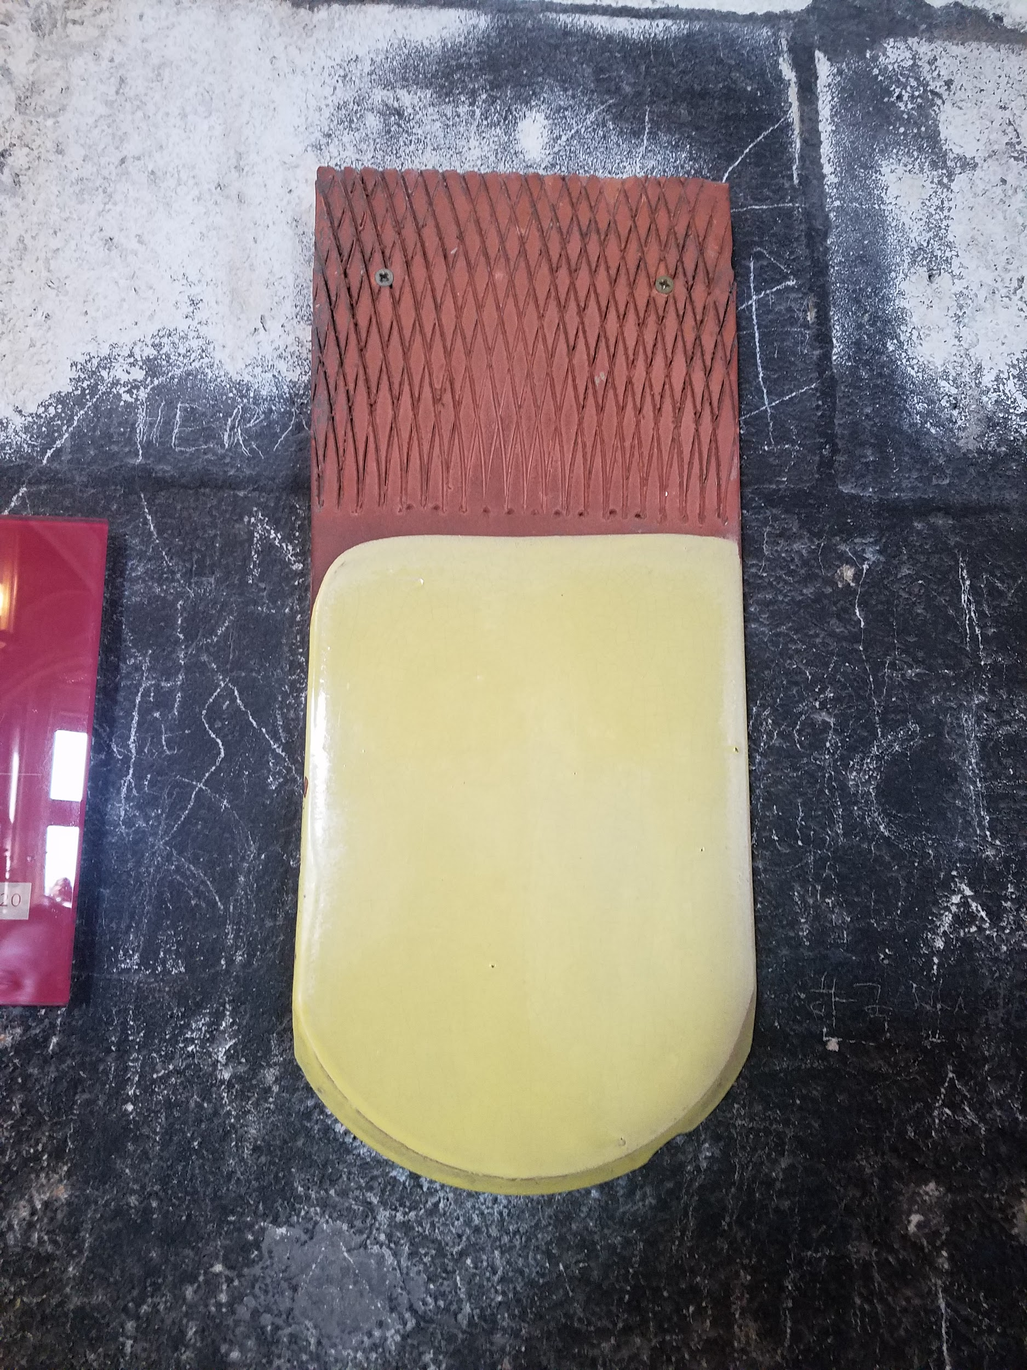
Stephansdom
A symbol of Austrian identity
A top class tourist attraction
Has 343 steps to get to the top with a great view of the city!
Plaza right outside!

Slide 9
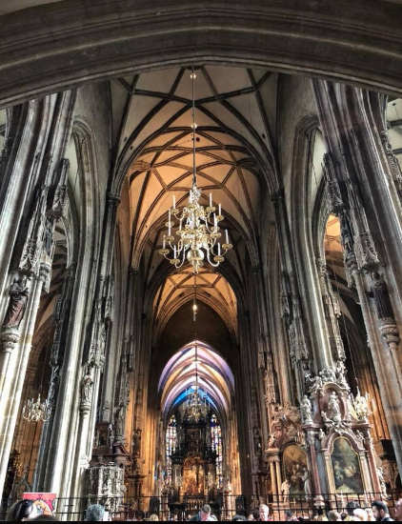
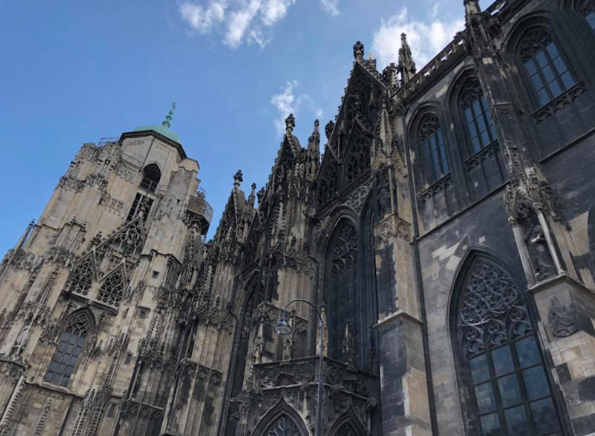
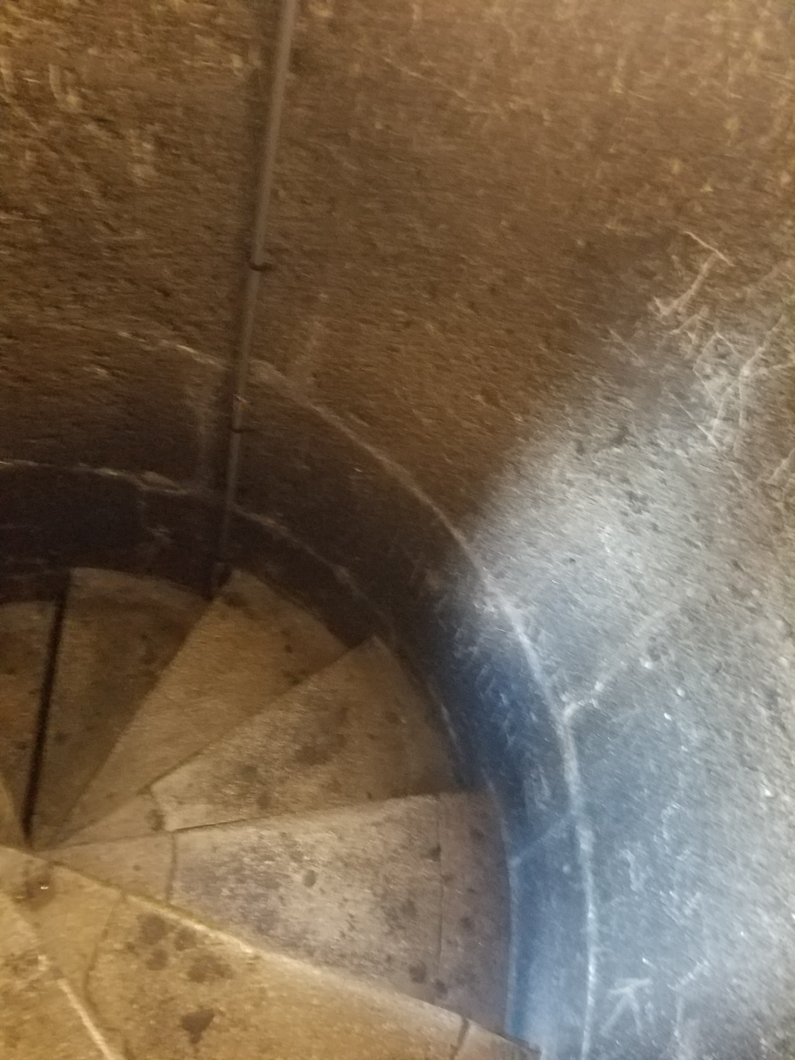
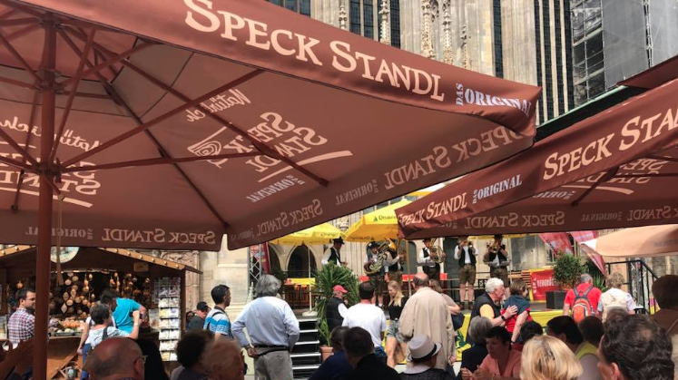
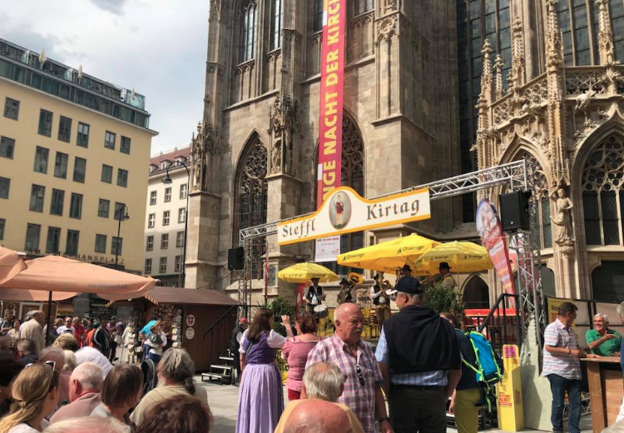

Slide 10
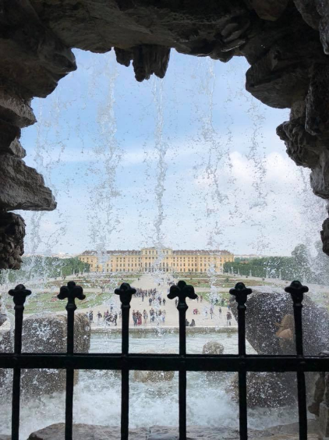
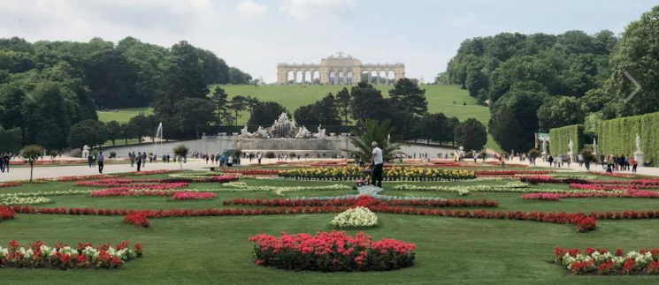
Schönbrunn Palace
Beautiful palace that features an immense amount of fountains and statues along with a huge garden
Gloriette at top of hill

Slide 11
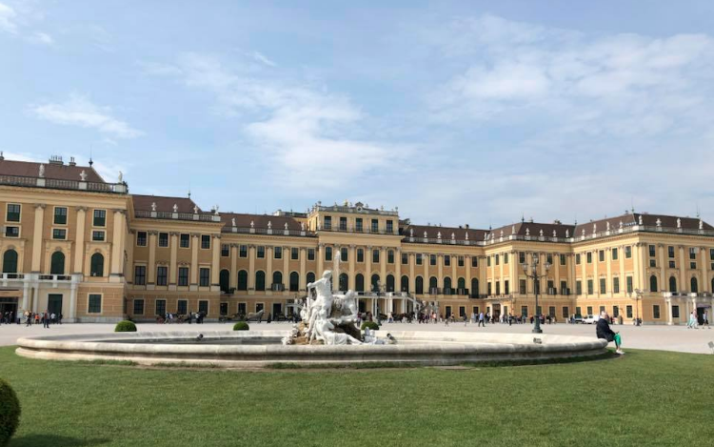
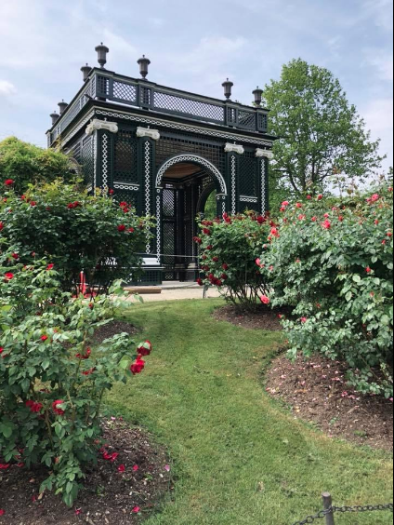
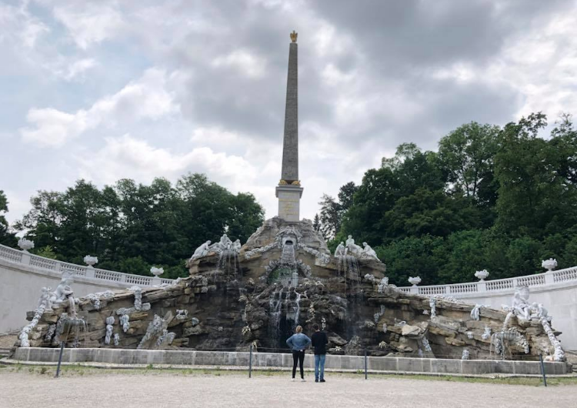
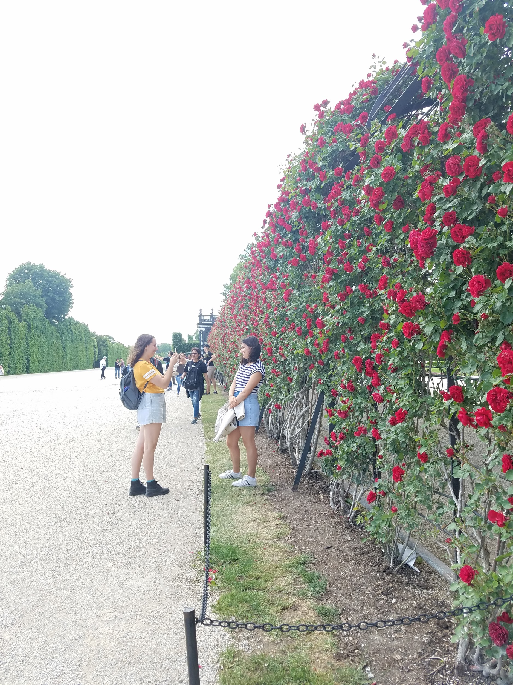
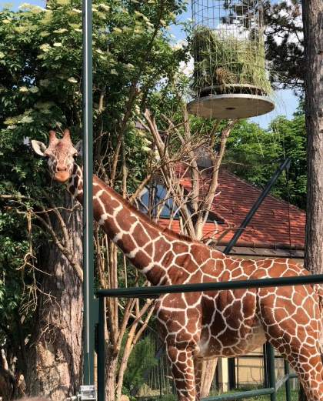
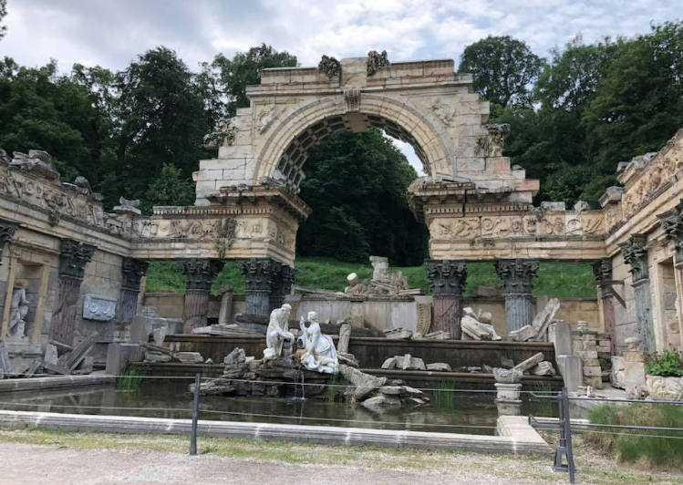

Slide 12
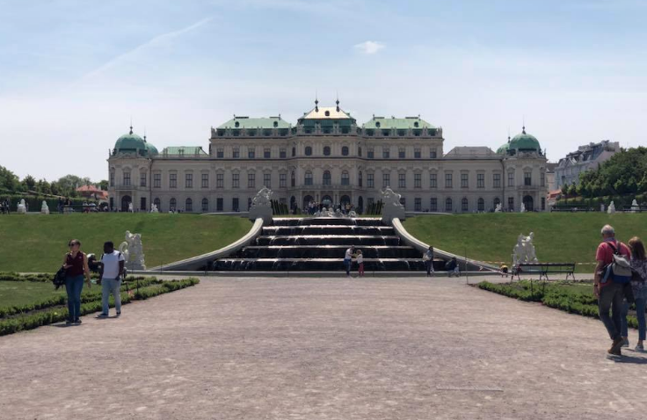
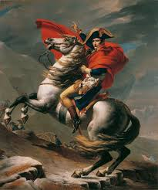
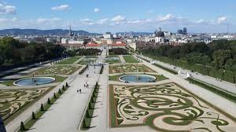
Belvedere
Built as the summer home to Prince Eugene of Savoy
Now home to the Österreichische Galerie Belvedere Art Museum
Filled with intricate gardens and hedge mazes
Some artwork include Napoleon Crossing the Alps, Gustav Klimt and more...

Slide 13
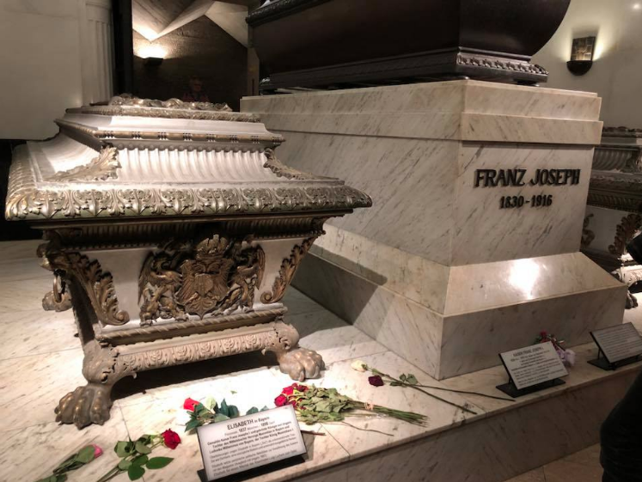
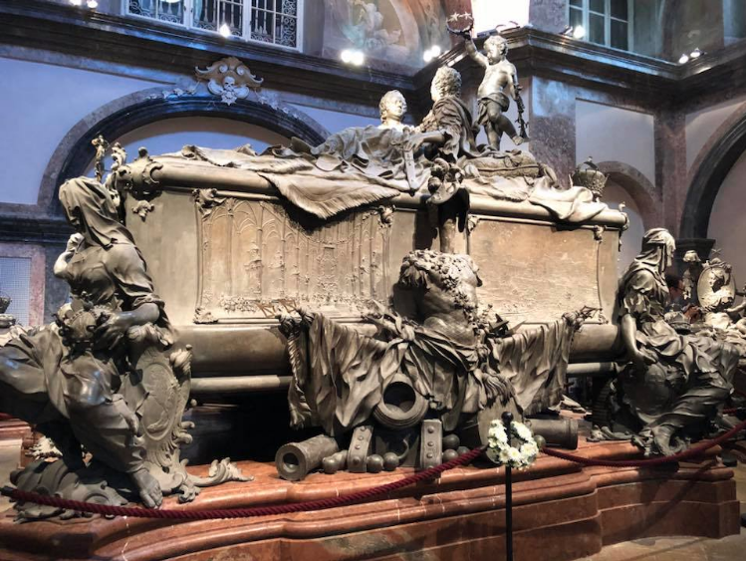
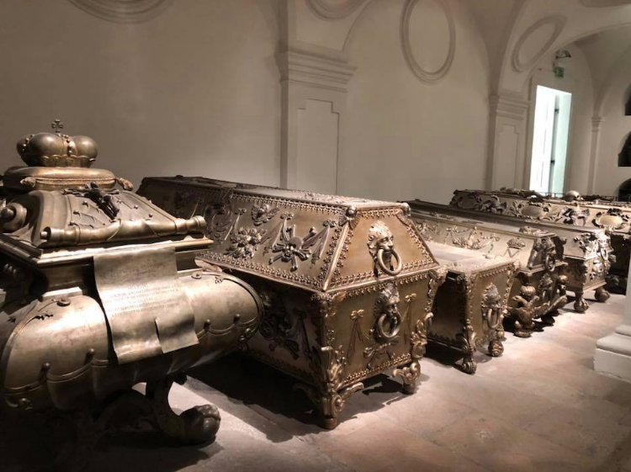
Imperial Crypt
Burial chamber for the members of the Habsburg
Located beneath the Capuchin Church

Slide 14
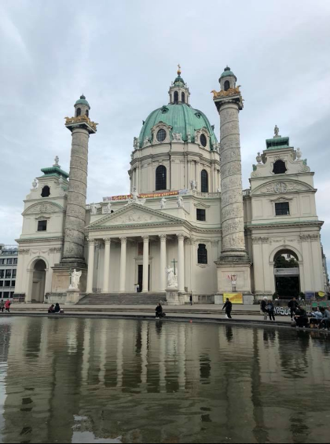
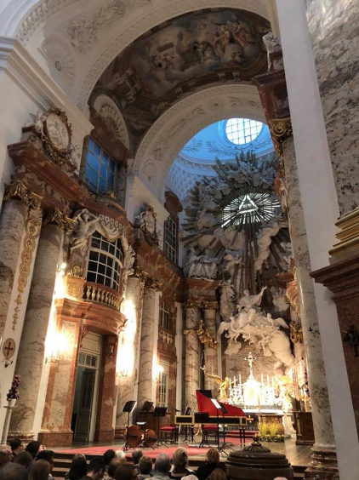
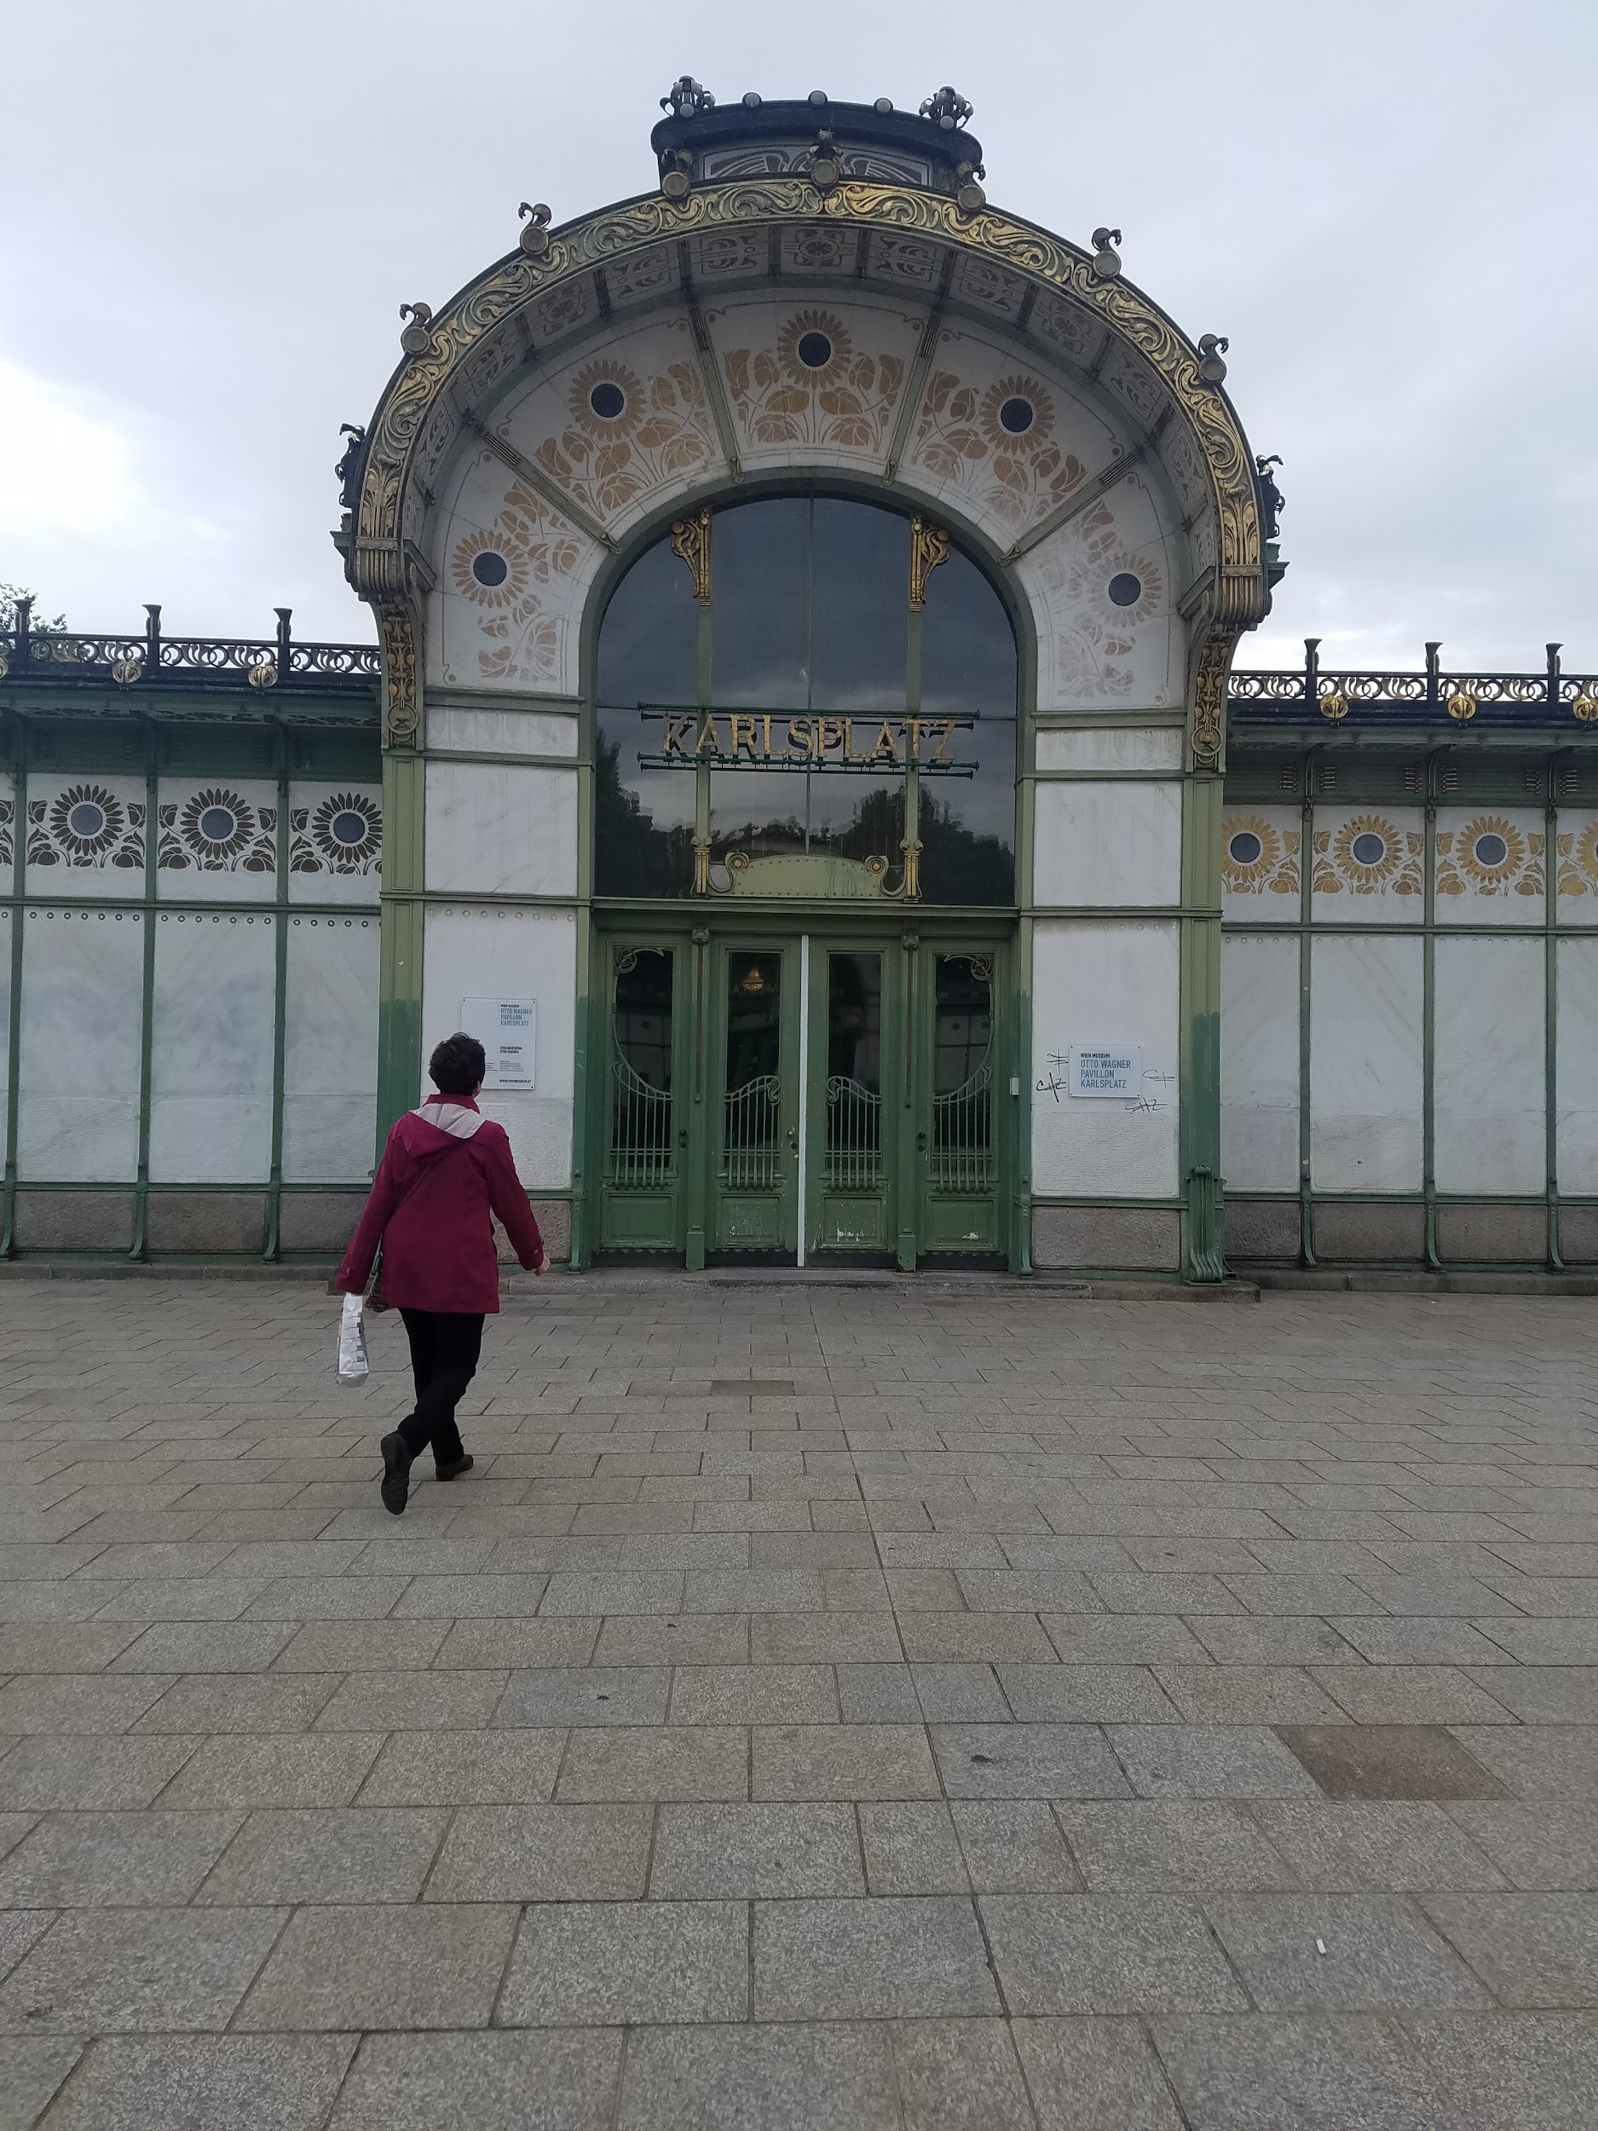
Karlsplatz Church and station
One of the many beautiful Austrian churches
We saw a concert performing Vivaldi’s “Four Seasons” there

Slide 15
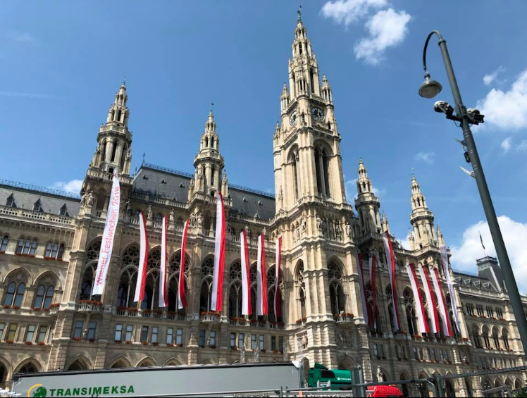
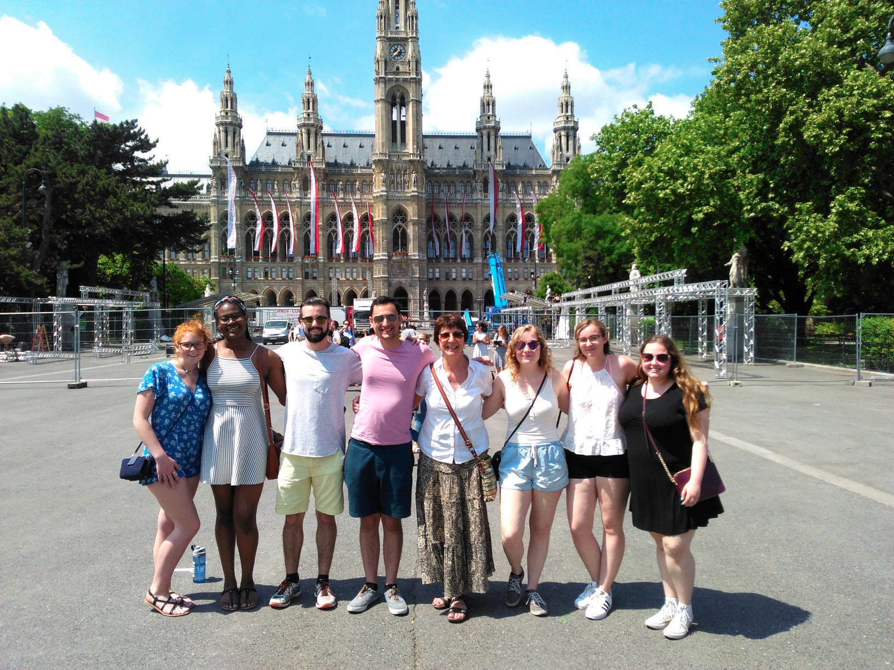
Rathaus

Slide 16
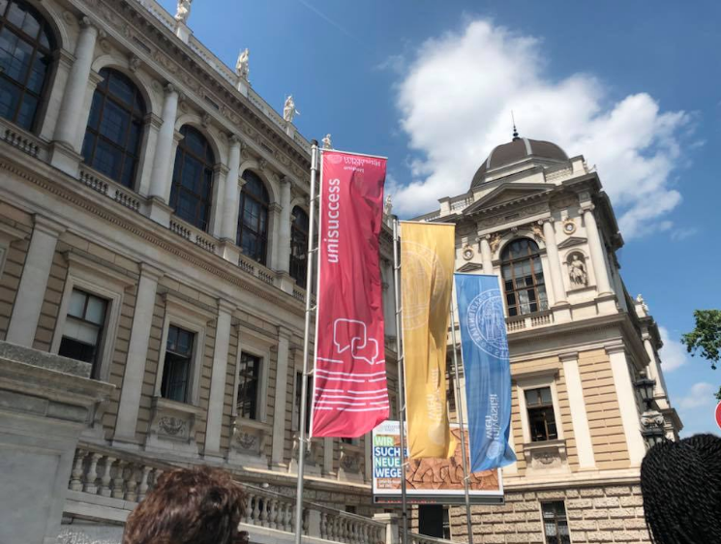
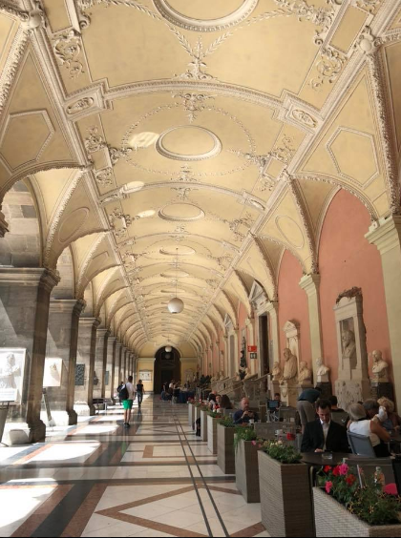
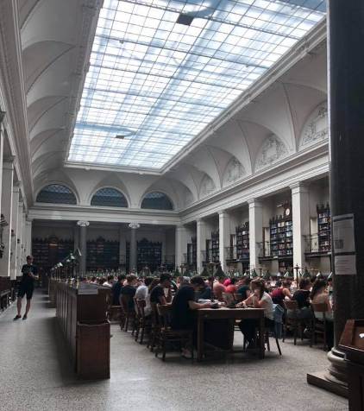
University of Vienna
Founded in 1365 and is one of the oldest universities in the German speaking world

Slide 17
Arts/Museums
(kunst/ Museen)

Slide 18
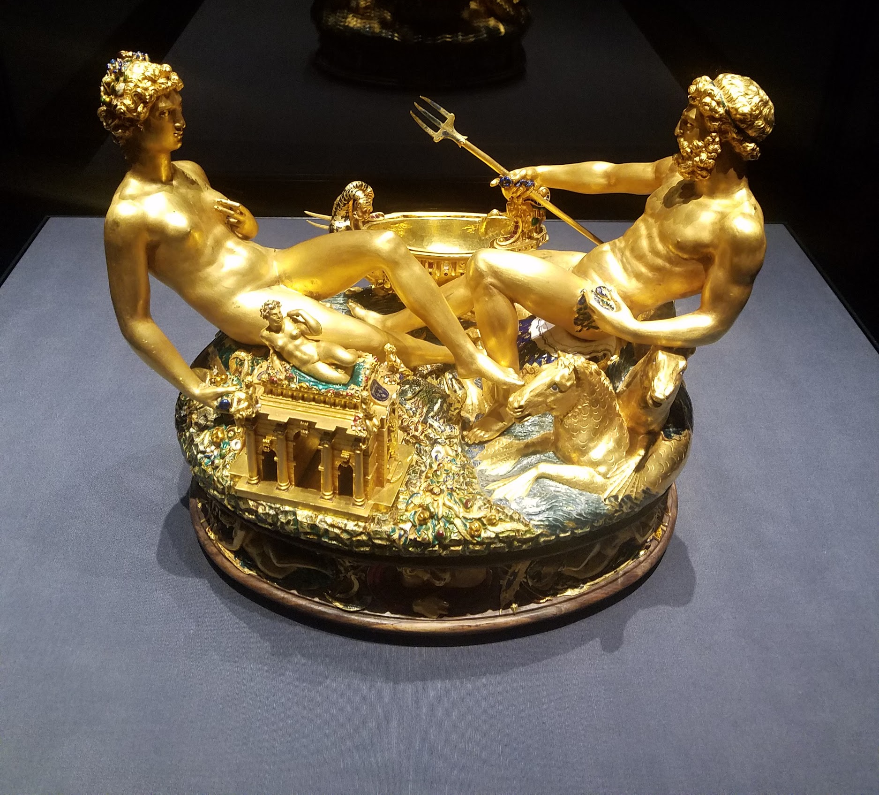
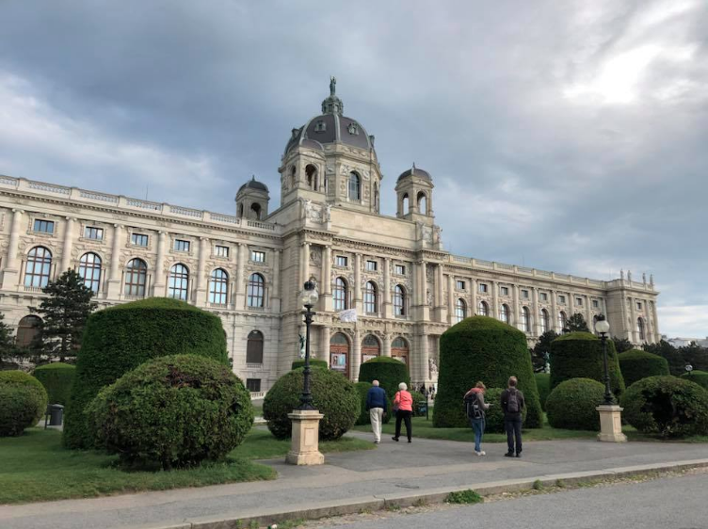
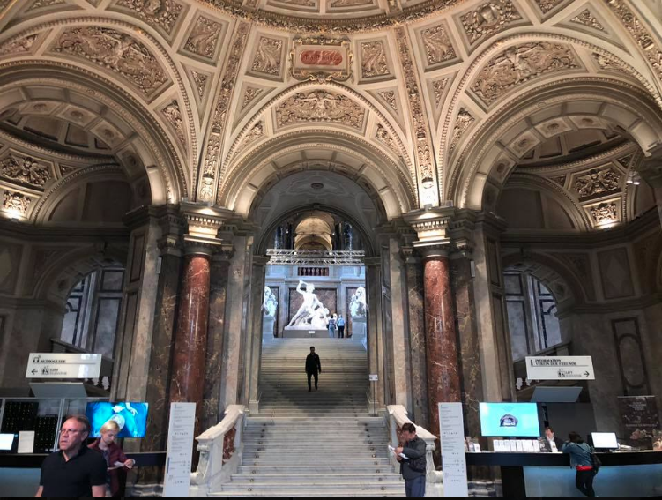
Kunst Historiches Museum

Slide 19
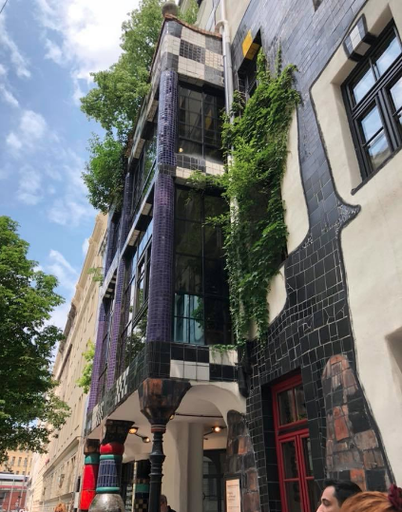
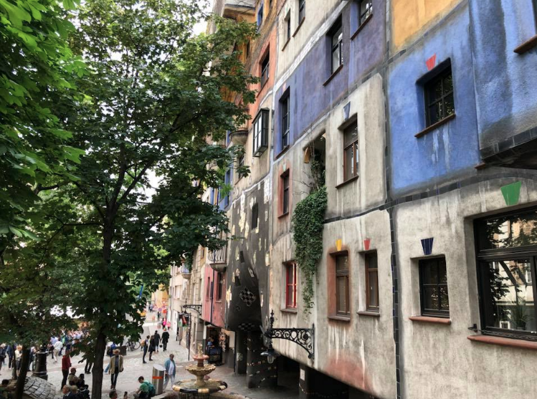
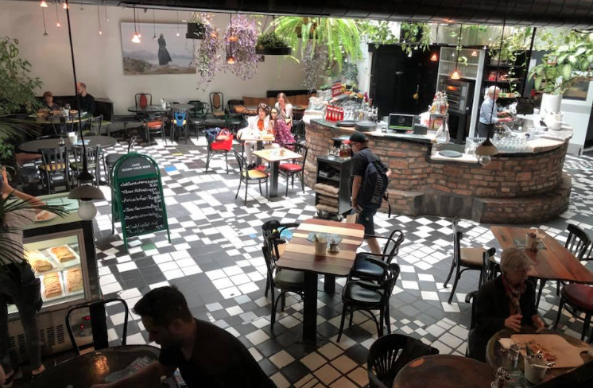
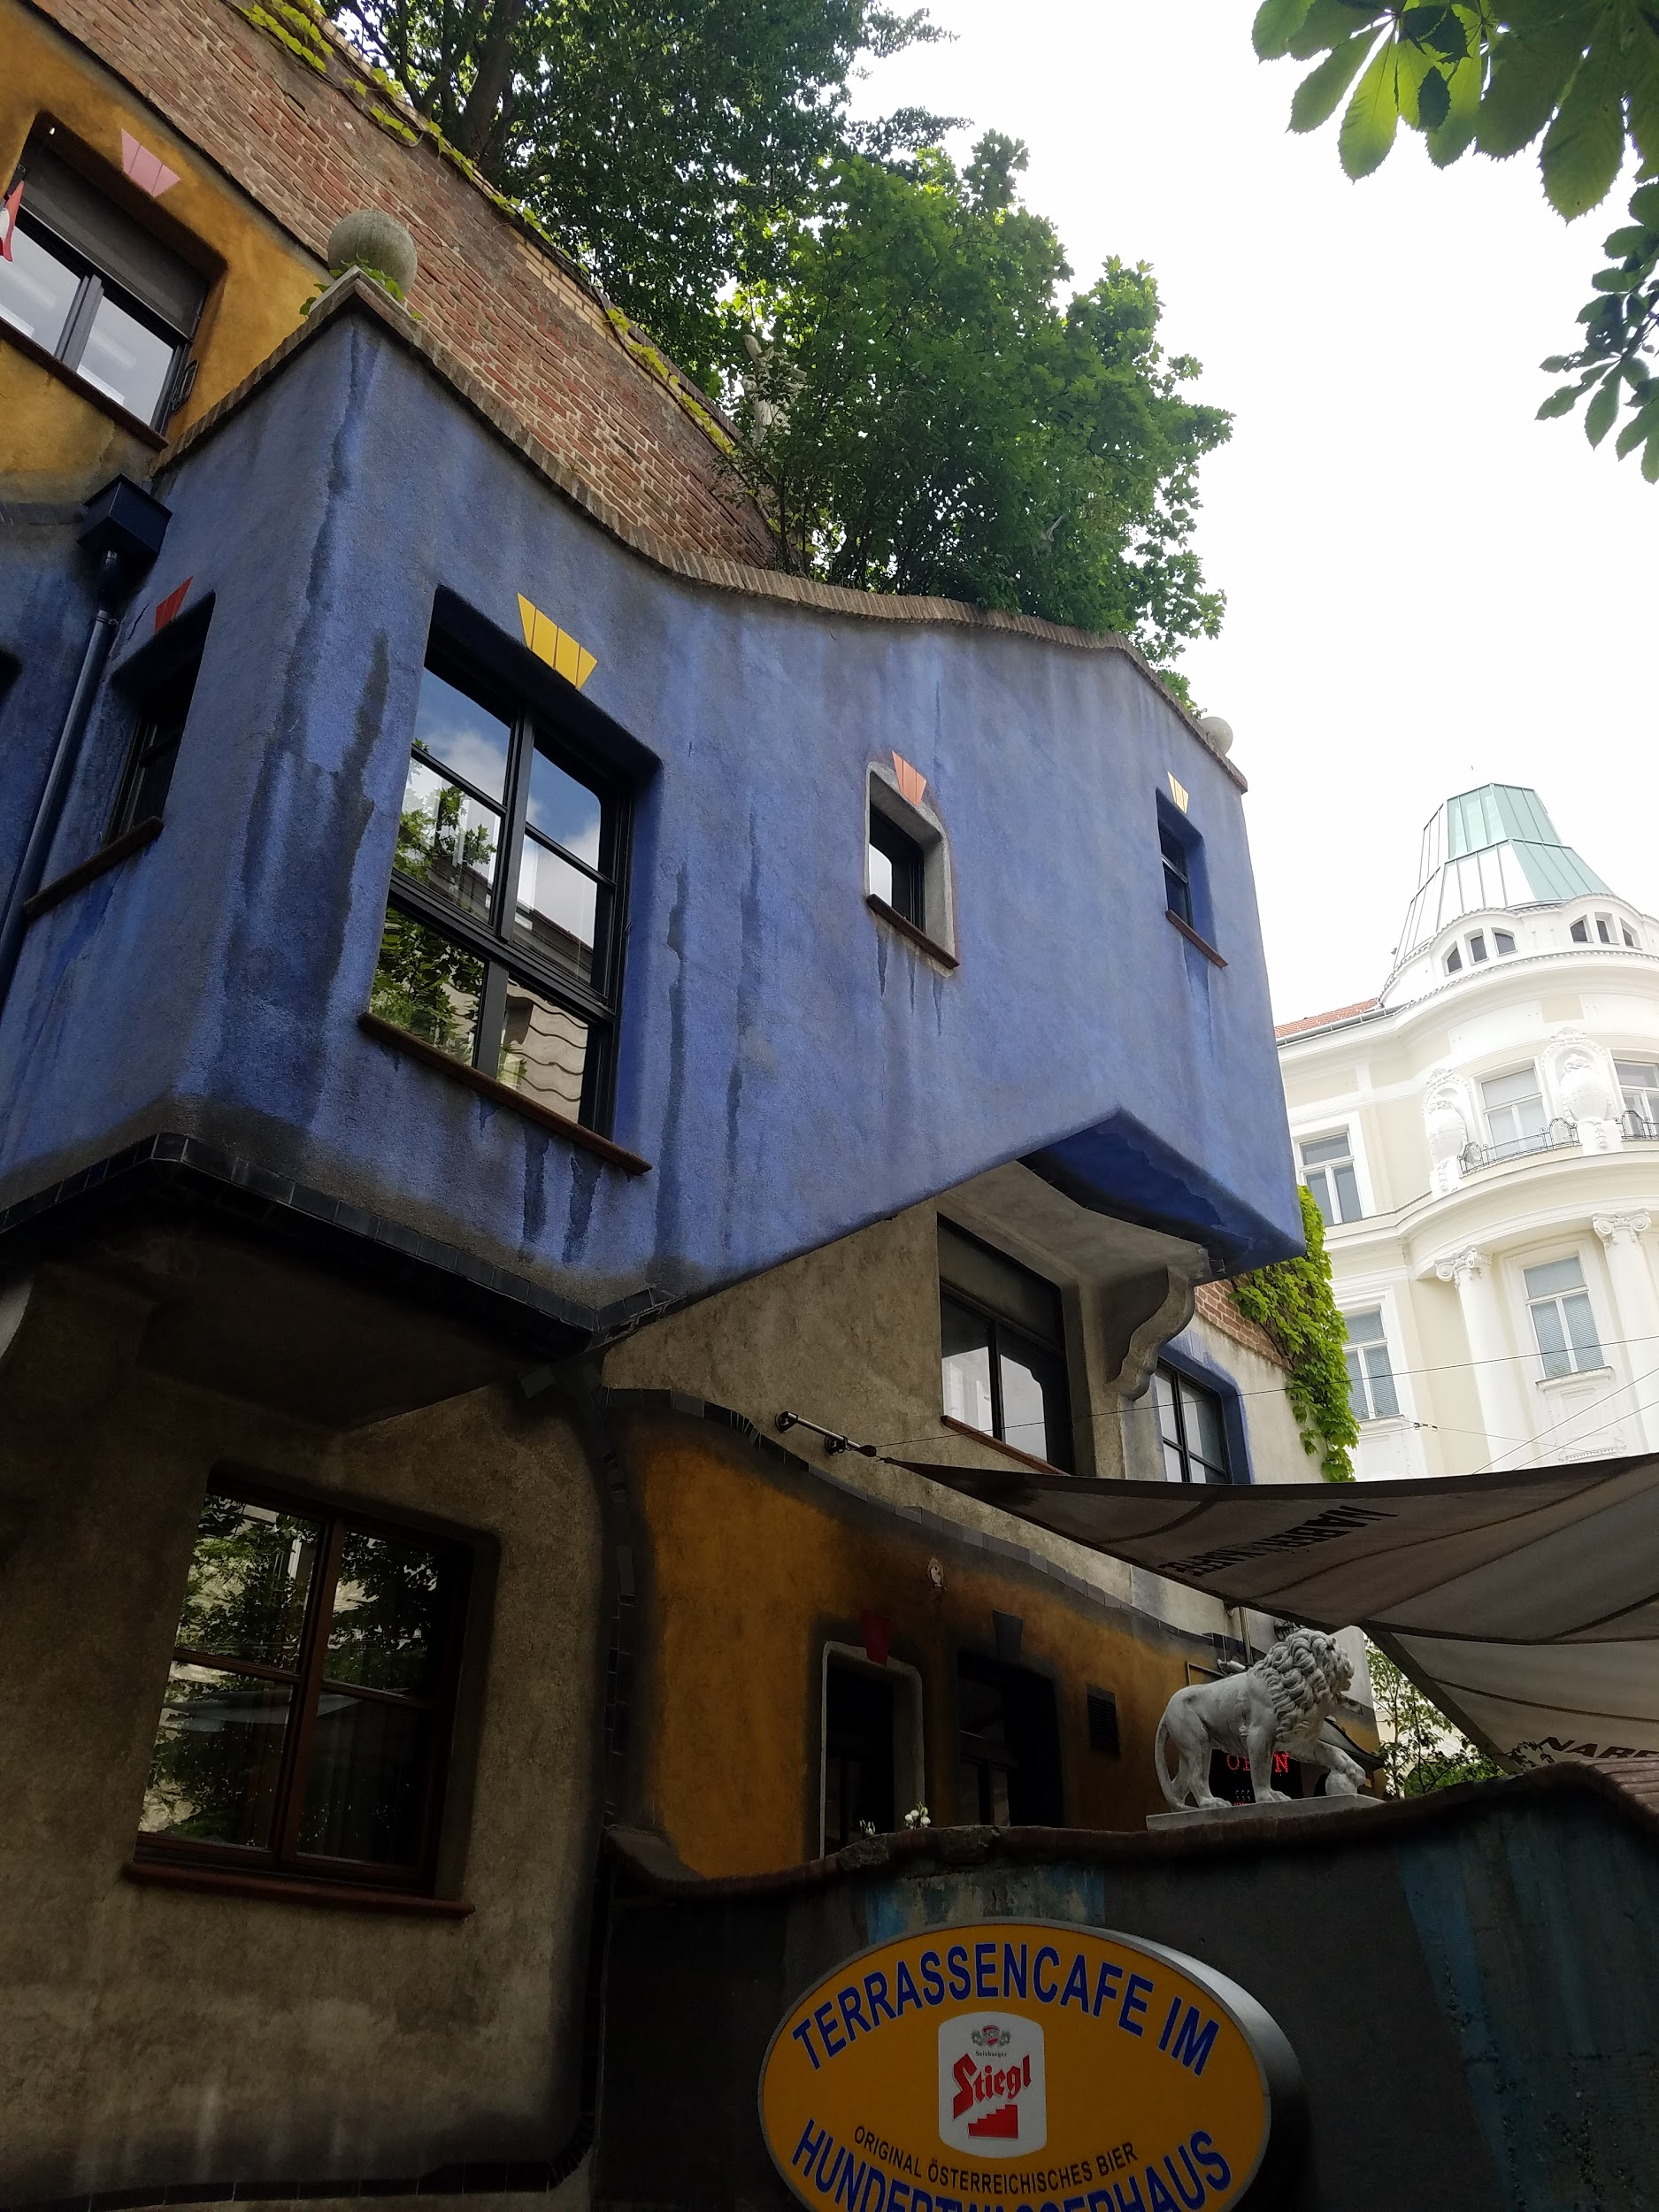
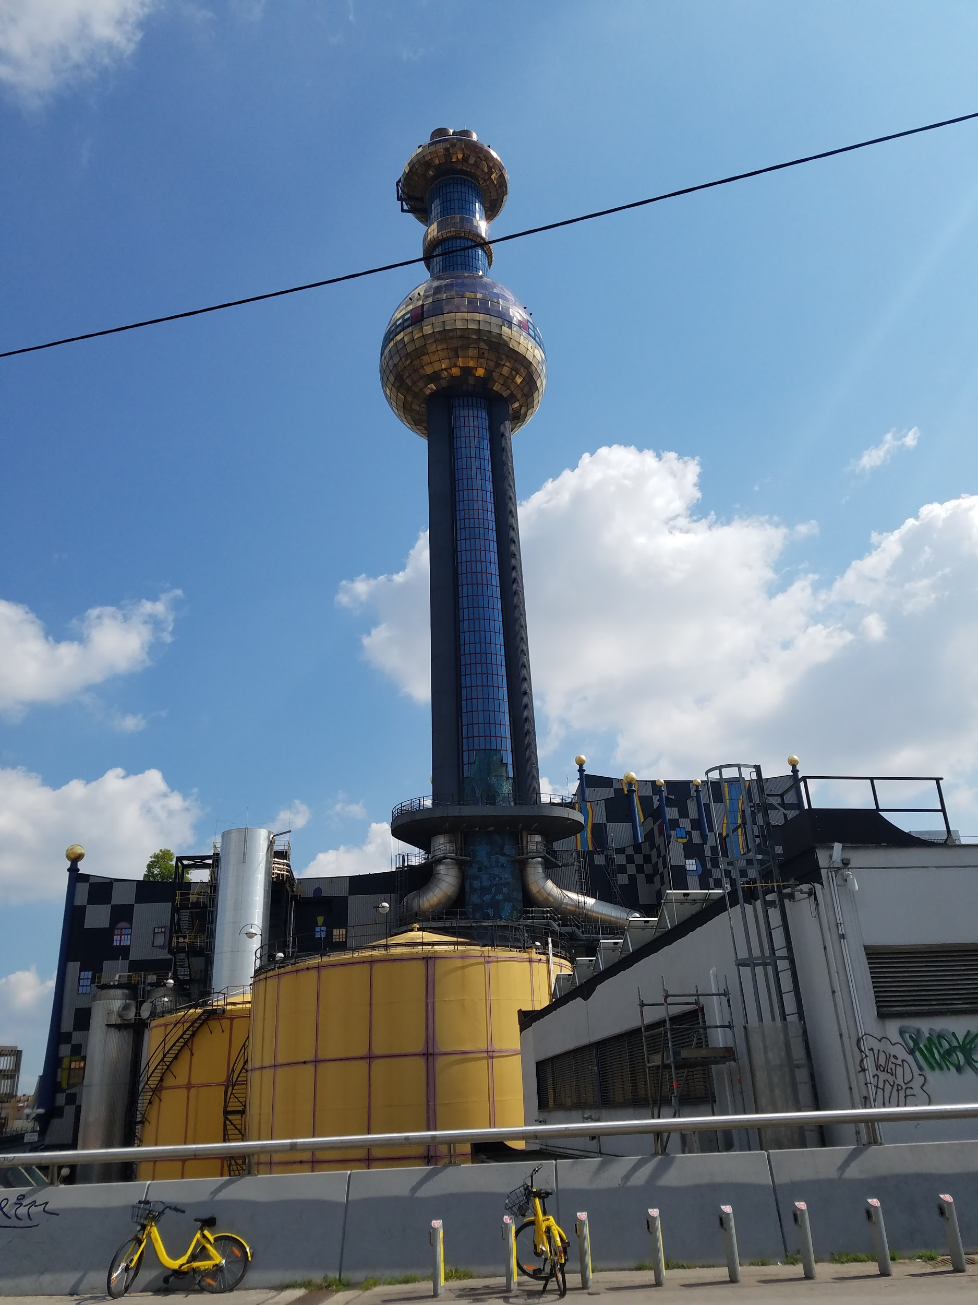
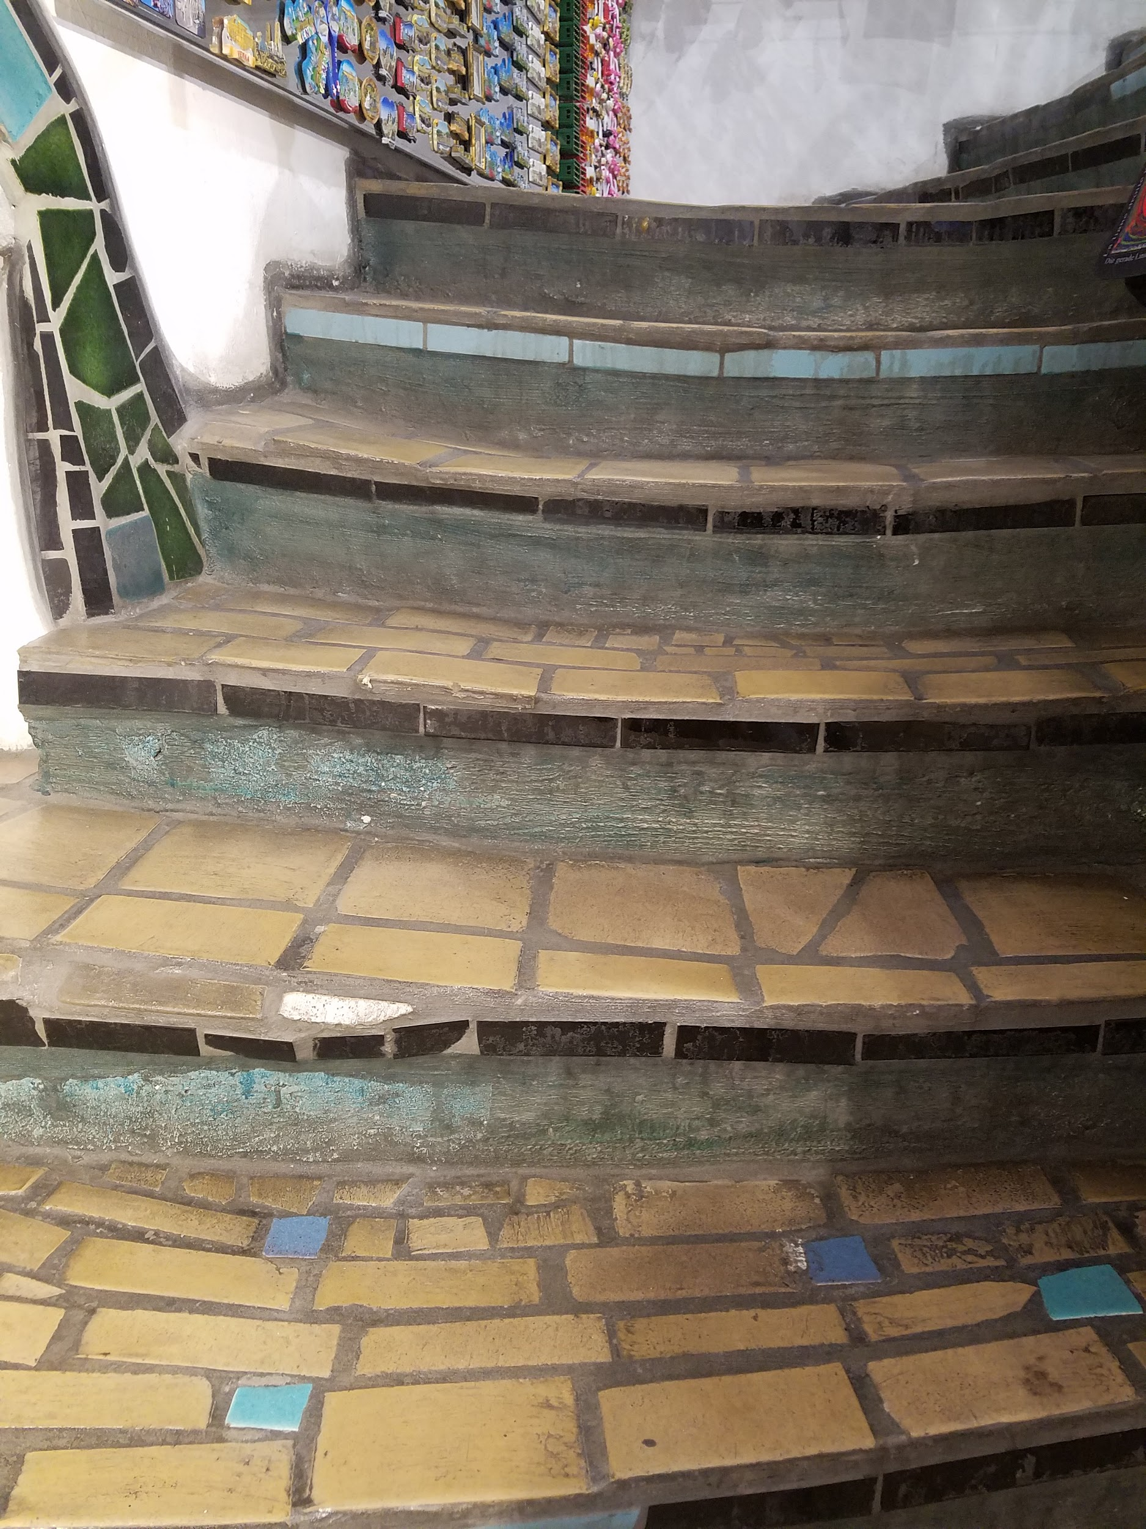
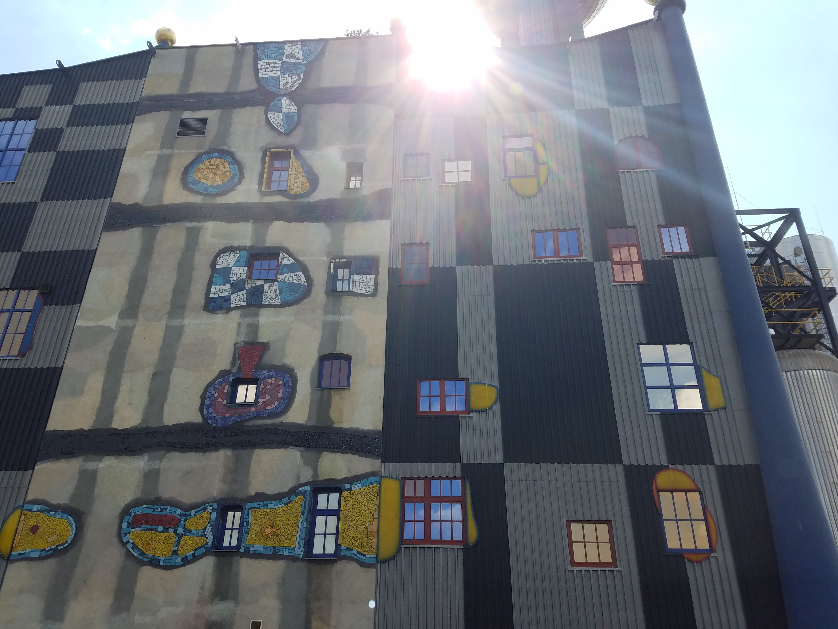
Hunderwasser Haus

Slide 20
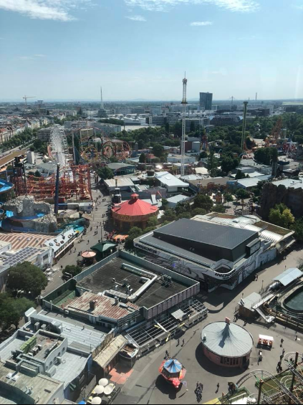
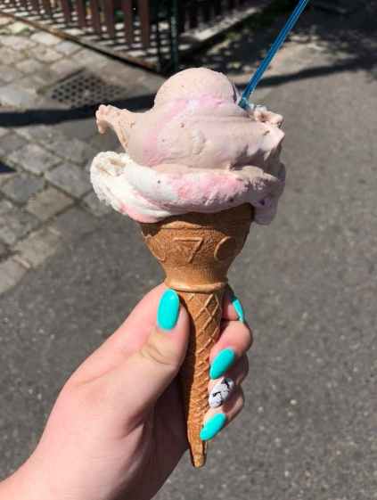
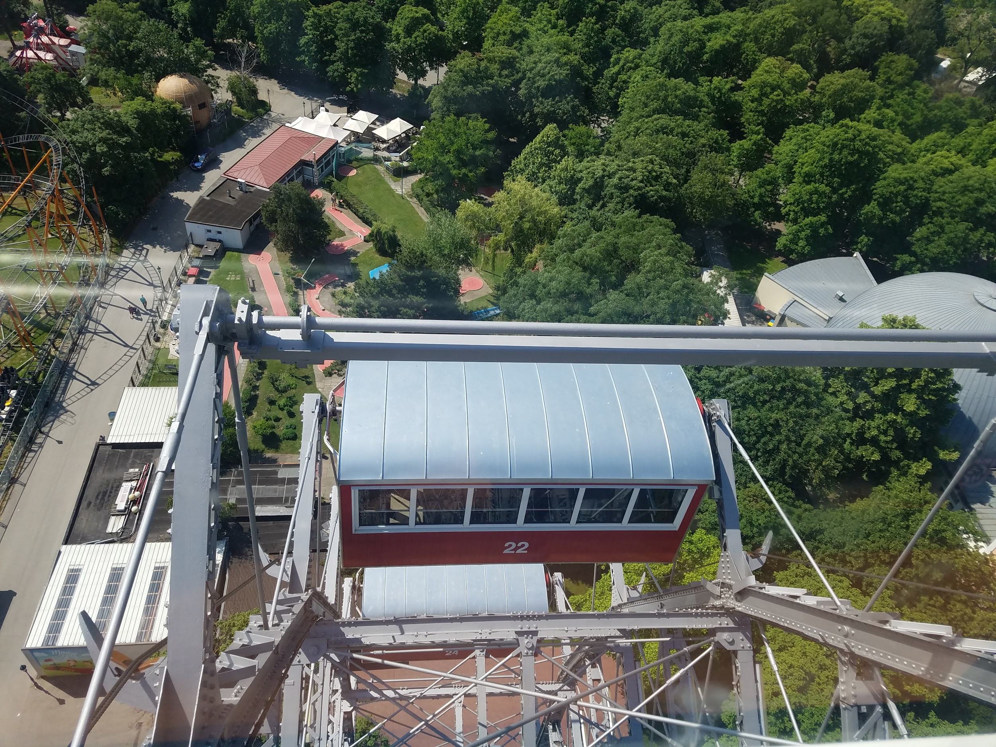
Prater/Riesenrad

Slide 21
People
(Menschen)

Slide 22
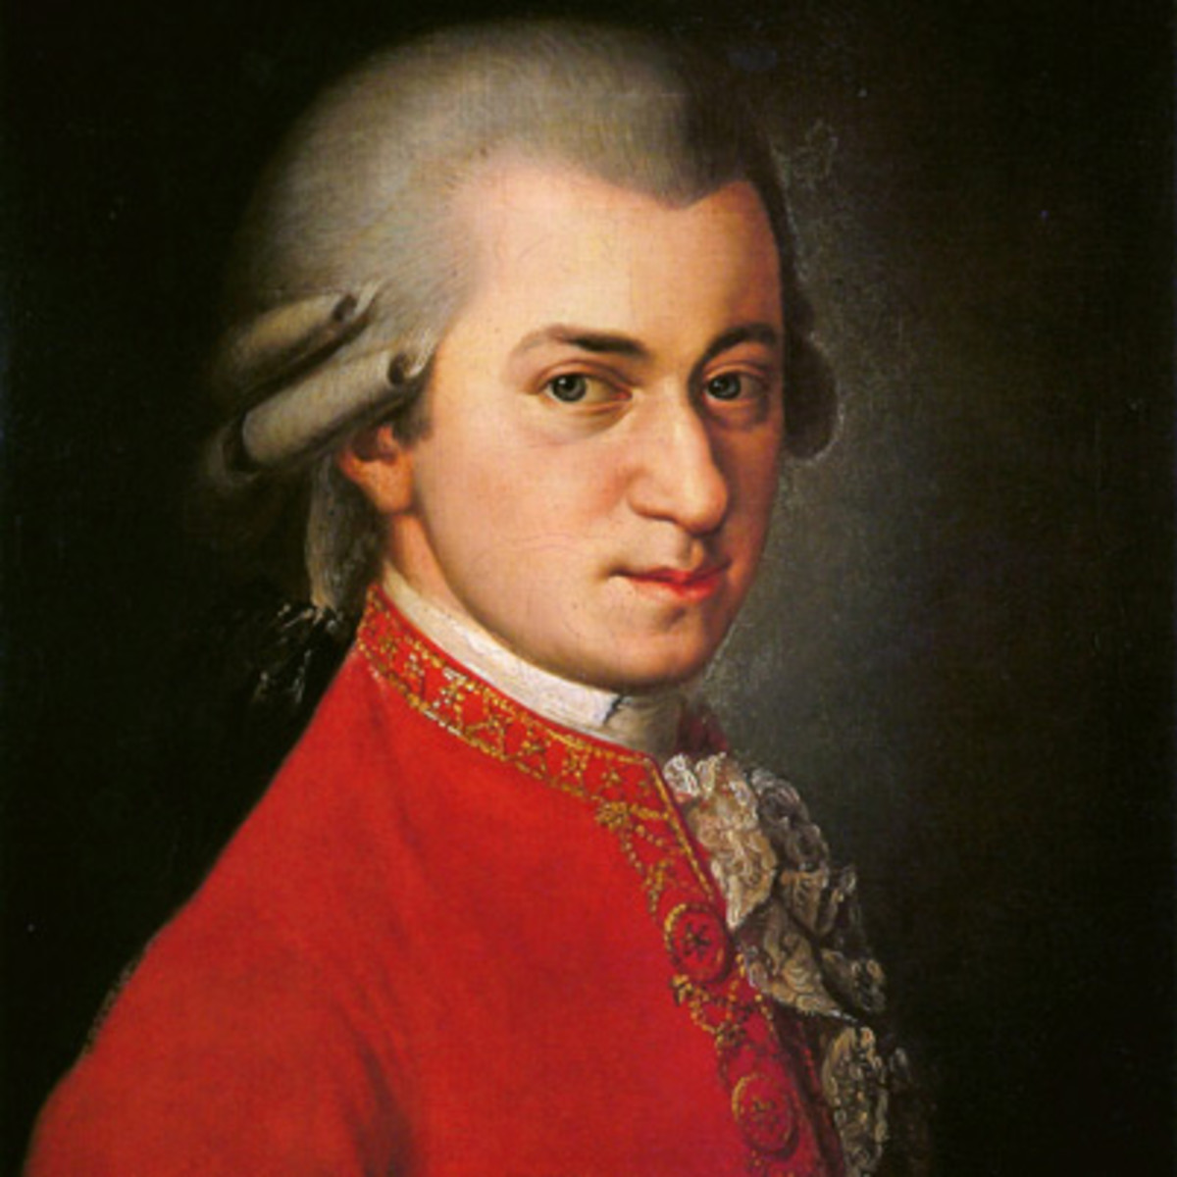
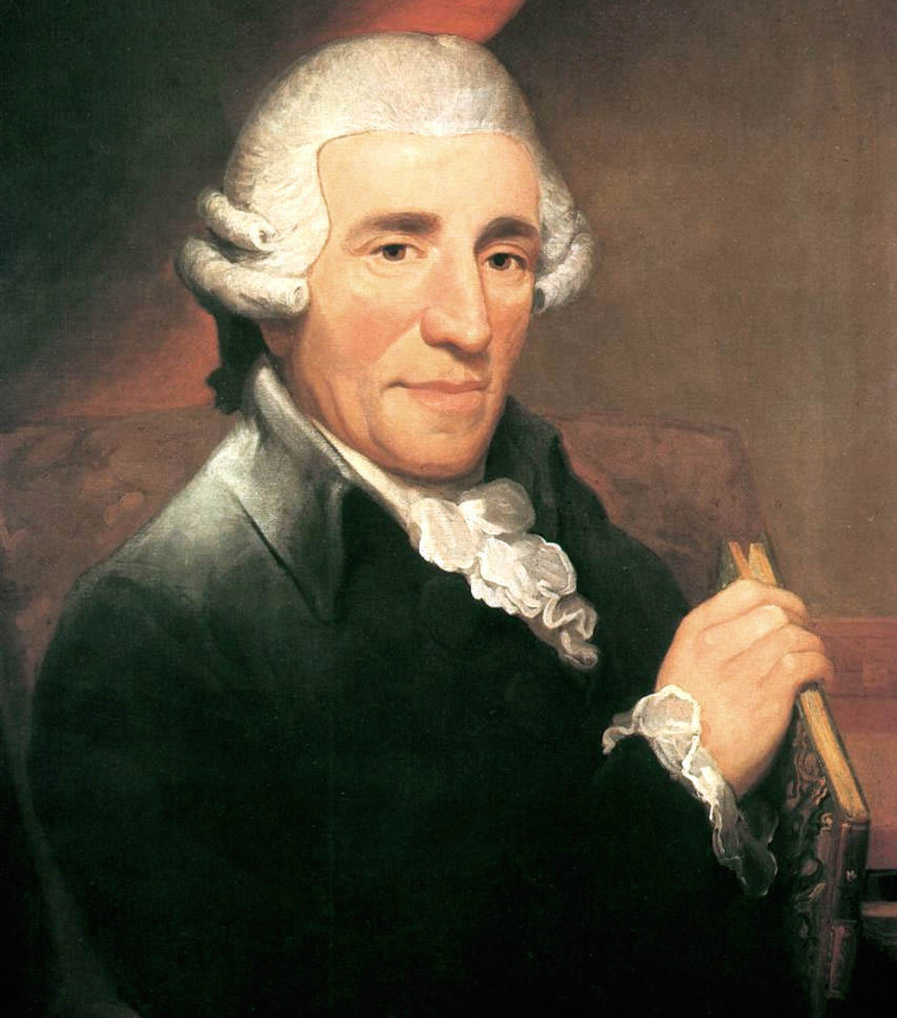
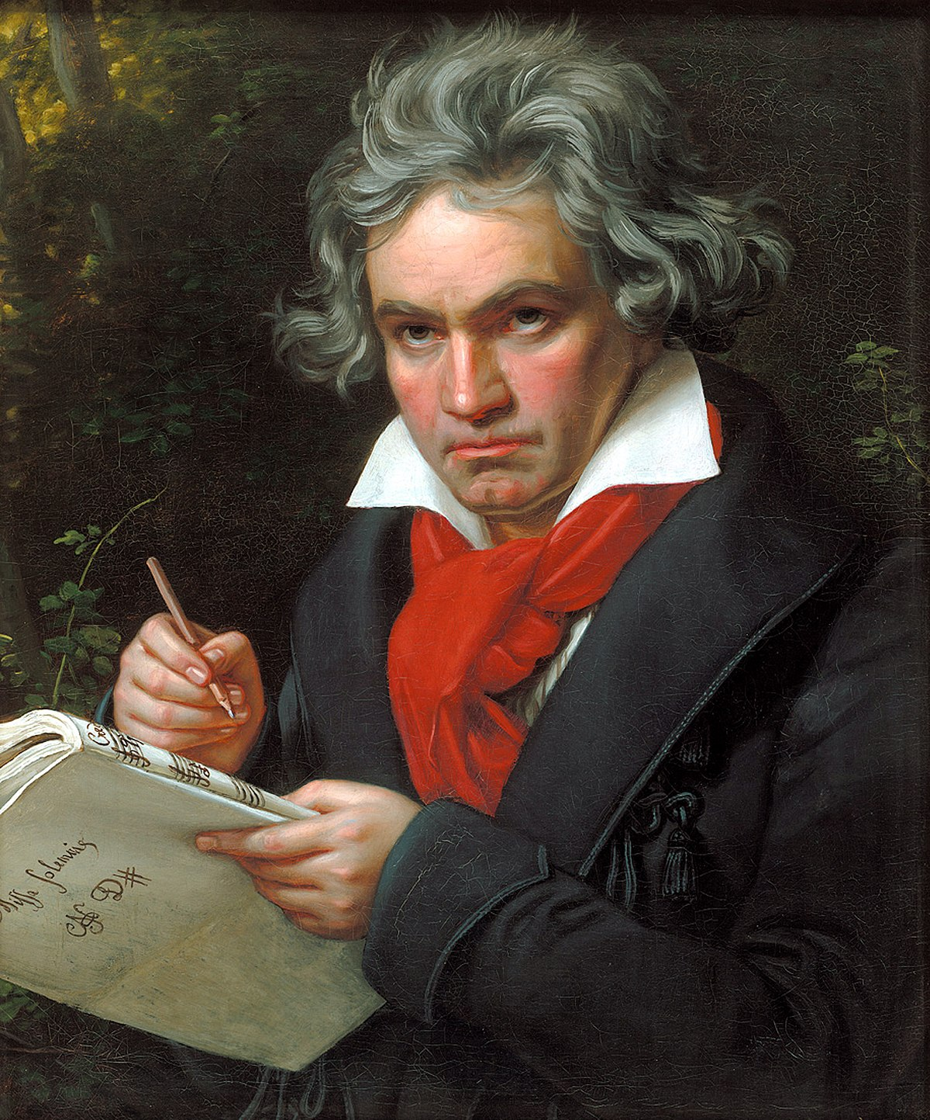
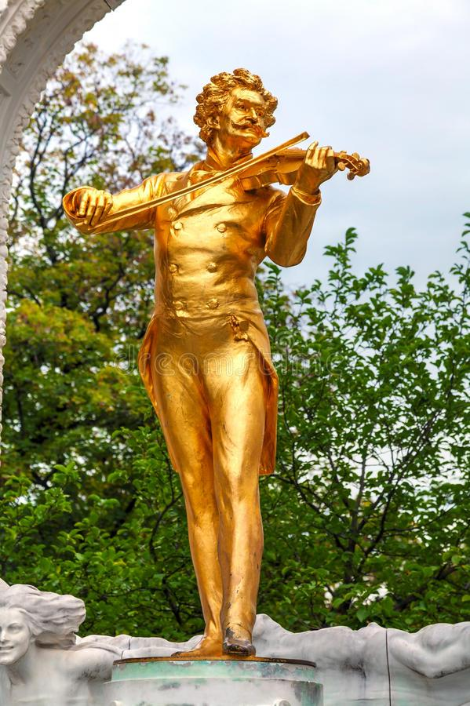
FAmous Musicians
Wolfgang Amadeus Mozart
Joseph Haydn
Ludwig Van Beethoven
Johann Strauss II
These inspirational artists founded the classical history of Vienna
They also founded the First Viennese School

Slide 24
Gustav Klimt
Austrian Painter
He brought forth a gold movement by incorporating gold leaf into his works
Famous paintings include The Kiss which resides in Vienna and The Woman in Gold

Slide 25
Sigmund Freud
It is Vienna where Freud began his practice
He is very well respected in Psychology and his ideals are still used to this day
His office is now open to the public as a museum
It includes his tools, journals and more

Slide 26
Franz Joseph
Last Habsburg Emperor
Created Austro-Hungarian Empire thanks in part to Empress Sissi
Suffered a lot of tragedies in his life

Slide 27
Empress Elisabeth of Austria
(Sisi)
Most well known empress of Austria
Had multiple houses/apartments around Vienna
Gave birth to many historical figures that impacted other important regions in Europe

Slide 28
Food
(essen)

Slide 30
Wiener Schnitzel
Thin Veal/pork cutlet that is breaded and then pan fried
Usually garnished with lemon or parsley
Popular cuisine for all ages!!

Slide 31
Bratwurst
Sausage that can be found from a home to a street stand!
Paired with spicy mustard and ketchup
Quick, easy and delicious

Slide 32
Liver Dumpling soup
Clear soup that has ground up liver shaped in a ball
Very light soup that is full of flavor!

Slide 33
Tafelspitz
Traditional Austrian dish that includes boiled beef or ham
Usually paired with knödel (white bread dumplings) and other meats

Slide 34
sachertorte
Symbol of the Austrian capital
A dense, chocolate sponge cake made with thin layers of apricot jam that's topped with chocolate icing.
Can be found at Hotel Sacher

Slide 35
Takeaway
Making tons of memories you will never forget!
Becoming close with the other students you went abroad with
Learning so much about another country’s history and culture

Slide 36
Danke!!
Fragen??

